Slide 1
CODE READABLTY && ST_Y_LE
All sortz uv things 2make proramming ez to read for all of the other peeple who wrk with the code on the very same problem sometimes or are jus trying to degub problemz or git ze code to werk somplace else where it didn’t used to work but now they want it to work for some reason maybe just to work the sameway something else works you know, though sometimes it may end up being easier just to rwrite than to reuse especially if you’re not really suer that the code in question actually is beng used for anything, maybe it’s just dead stuff and theirs no need to be compatable, wow that would be a releaf because really you could do a lot betr than the old crusty clumpy flaky code.

Slide 2
Software Engineering
Don’t try to do everything
But execute what you choose to do well.
Test as you go
Easier to build if the foundation is reliable
Keep it consistent
100 ways to do things == 100 ways to remember things
Locality and modularity
Only needing to understand what you’re working on
Readability
Whitespace, paragraphing, naming, commenting.

Slide 3
For starters – four easy things to avoid in code that will make it much easier to read

Slide 4
1) contrasting colors
Int main(int argc, char argv)
/* Process command line and call routine that does actual work */
{
optionInit(&argc, argv, options);
blockSize = optionInt("blockSize", blockSize);
itemsPerSlot = optionInt("itemsPerSlot", itemsPerSlot);
bedFields = optionInt("bedFields", bedFields);
as = optionVal("as", as);
doCompress = !optionExists("unc");
if (argc != 4)
usage();
bedToBigBed(argv[1], argv[2], argv[3]);
optionFree();
return 0;
}

Slide 5
2) busy backgrounds
Int main(int argc, char argv)
/* Process command line and call routine that does actual work */
{
optionInit(&argc, argv, options);
blockSize = optionInt("blockSize", blockSize);
itemsPerSlot = optionInt("itemsPerSlot", itemsPerSlot);
bedFields = optionInt("bedFields", bedFields);
as = optionVal("as", as);
doCompress = !optionExists("unc");
if (argc != 4)
usage();
bedToBigBed(argv[1], argv[2], argv[3]);
optionFree();
return 0;
}

Slide 6
3) Fancy Fonts
int main(int argc, char argv)
/* Process command line and call routine that does actual work */
{
optionInit(&argc, argv, options);
blockSize = optionInt("blockSize", blockSize);
itemsPerSlot = optionInt("itemsPerSlot", itemsPerSlot);
bedFields = optionInt("bedFields", bedFields);
as = optionVal("as", as);
doCompress = !optionExists("unc");
if (argc != 4)
usage();
bedToBigBed(argv[1], argv[2], argv[3]);
optionFree();
return 0;
}

Slide 7
4) Circular Representations

Slide 8
Programming Style Guides

Slide 9
Programming Style Guides
Aim to improve readability, ease memory burden
Encourage consistency, promote reuse
Helps make important things STAND OUT
Style needs to be simple, not too much work to maintain.
There is no one true style, just endless local variations. Tend to adopt local style.
Our C style guide is in the code conventions section of kent/src/README.
Python style guide is in kent/python/style.txt

Slide 10
Switch to README

Slide 11
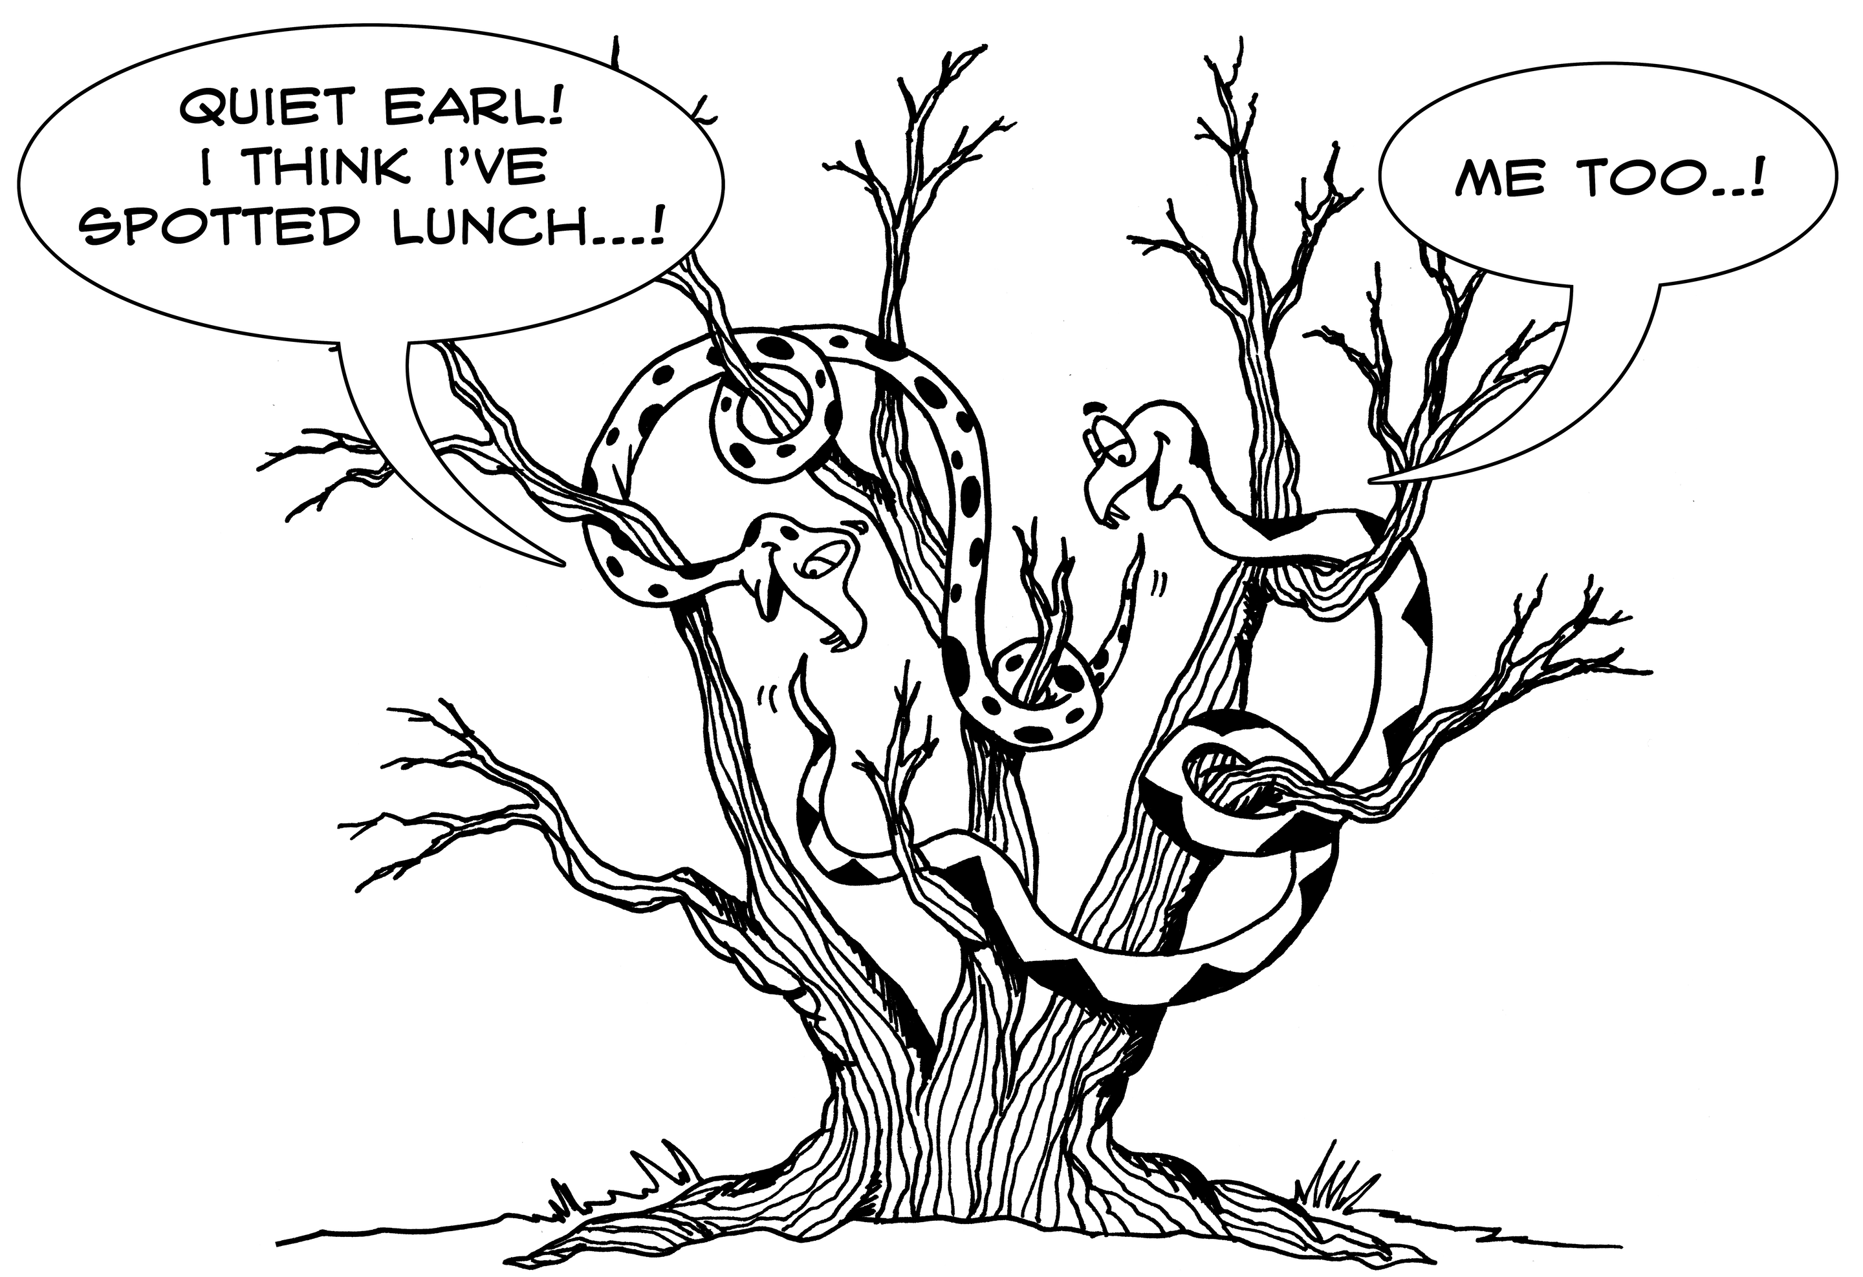
Reasons to follow style guide 1
To avoid the unfortunate results of a shared mess.

Slide 12
Reasons to follow style guide 2
To avoid strong feedback during code review.

Slide 13
Reasons to follow style guide 3
For Jim’s emotional equilibrium
“WTF? I’m _paying_ for this code?”
“Styling! Nice clear flow of logic.”

Slide 14
Reasons to follow style guide 4
For the children – succeeding generations of programmers will have an easier time understanding project and reusing its code.

