Slide 1
Distributed Data Architectures and a little ENCODE
Jim Kent, UC Santa Cruz

Slide 2
A little ENCODE

Slide 3
There is a need to do integrated tracks!
Some work going on at UCSC
Hope to bring in integrated tracks from analysis working group as well

Slide 4
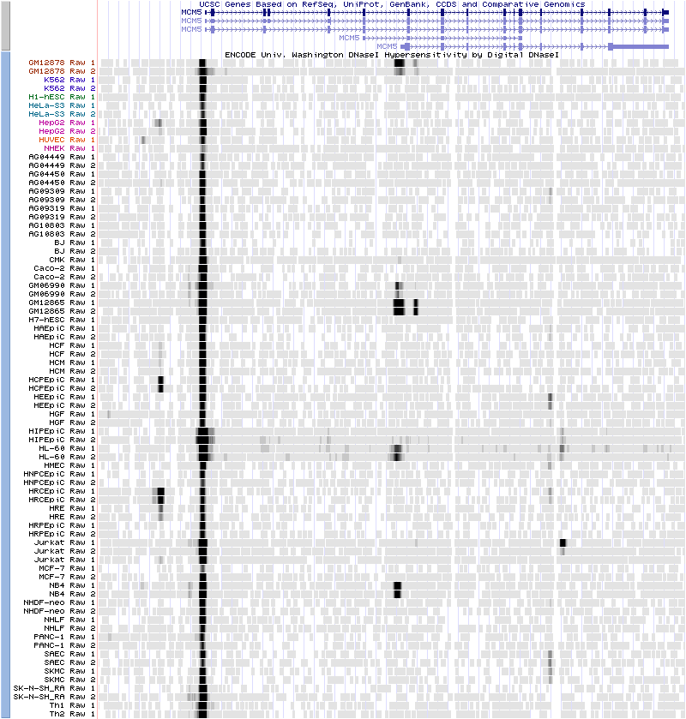
UW DNAse all signals (so far!)

Slide 5
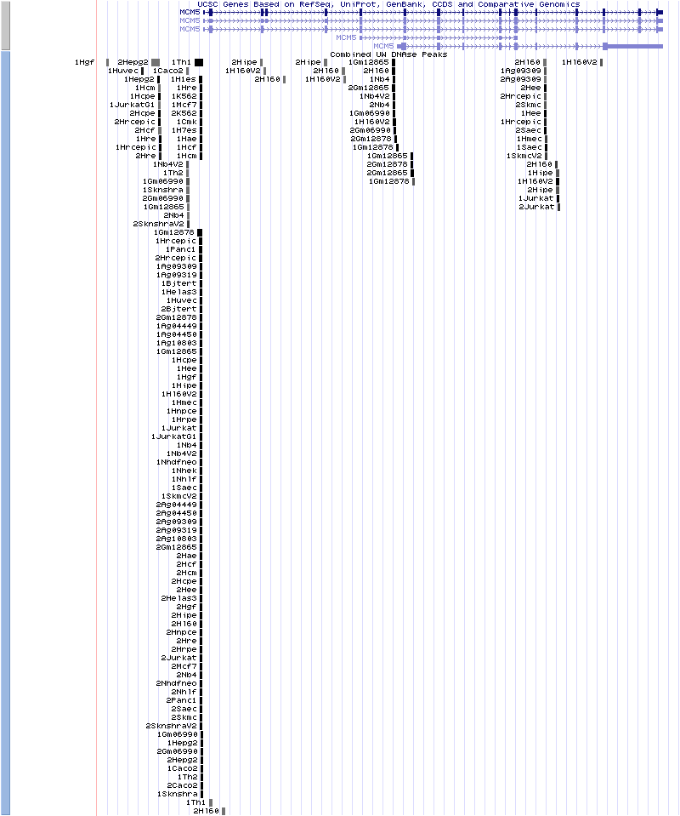
UW DNAse Combined Peaks

Slide 6
UW DNAse Merged
The number to the left indicates the number of samples (replicates of cell lines) in which the peak is seen.

Slide 7
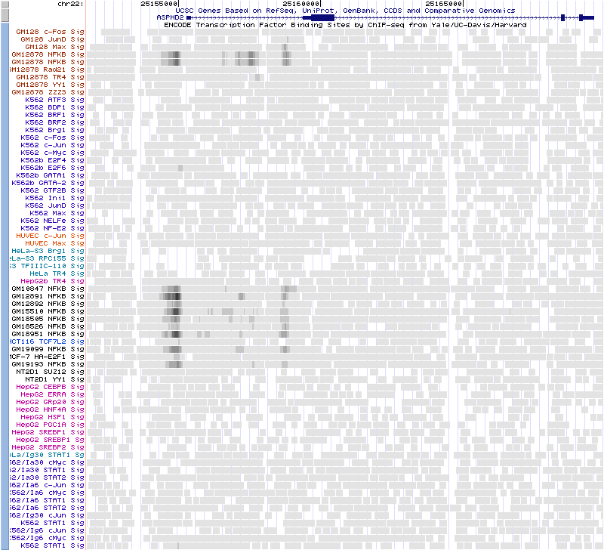
Yale TFBS Raw Signals (no Pol)

Slide 8
Yale TFBS Combined Peaks
Various peak-called “tracks” combined into a single track with label being cell-line/factor. Good, but still get “stacks,” mostly of common factors seen in many cell lines.

Slide 9
Yale TFBS Merged Peaks
Letters to right indicate which cell lines peak is seen in:
A Gm10847
B Gm12891
C Gm12892
D Gm15510
E Gm18505
F Gm18526
G Gm12878
H Helas3
I Hct116
K K562
L Hepg2
M Mcf7
N Nt2d1
X Gm18951
Y Gm19099
Z Gm19193

Slide 10
Merging Process
Very simple minded – peaks from same factor in different cell lines that overlap are
merged. Extents of merged peak encompass all peaks it is made of.
Would be happy to use something more sophisticated from analysis working group.

Slide 11
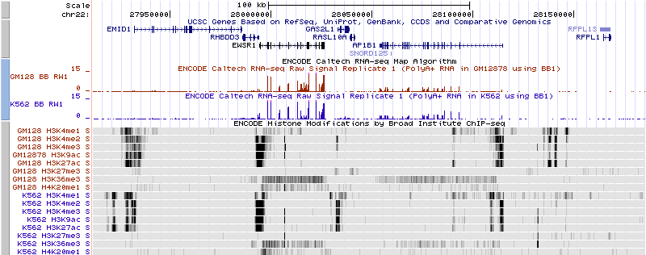
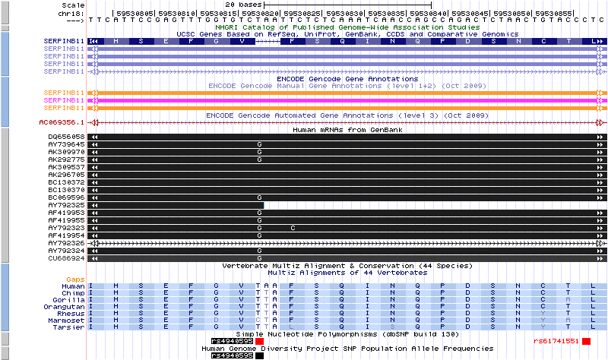
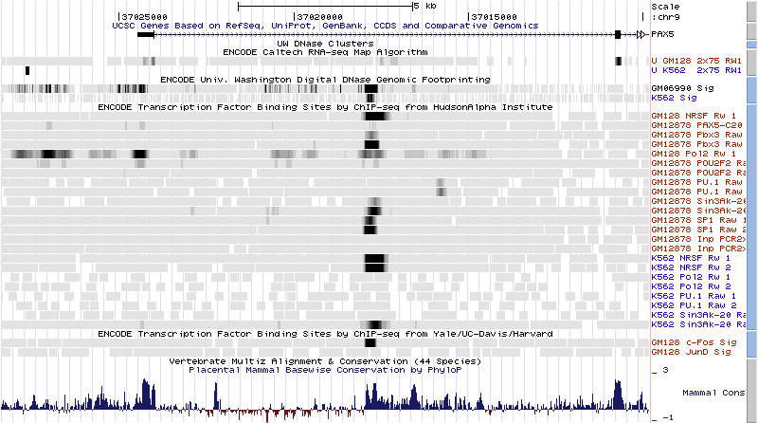
Browser ENCODE Session Gallery
Basic ENCODE data on the tier 1 cell lines GM128, a lymphoid cell line and K562, a myeloid line. The tracks include RNA-seq which shows the level of expression of the gene EWSR1, the histone marks H3K4Me3 which is associated with promoters, DNAse I hypersensitivity which is associated with regulatory regions in general, and ChIP-seq showing levels of occupancy by the transcription factor c-Fos.
Histone ChIP-seq data on the two tier one cell lines. H3K4me1 is associated with enhancers and to an extent with promoters, H3K4me3 is associated with promoters, and H3K36me3 with transcribed regions.
A premature stop codon that is found in the reference genome and about half of people of European descent. The UCSC Genes track is forced to skip the codon.
Regulatory elements in the promoter and first intron of the transcription factor PAX5, a gene expressed in GM128 but not K562 cells. The data suggests a complex regulatory circuit with some autoregulation.
Gallery linked to main ENCODE page. Clicking on image takes you to browser at that
spot with those tracks configured as shown. Caption explains session to non-specialists.

Slide 12
2009 Proposal for Architecture of UCSC Genome Browser
Jim Kent
Genome Bioinformatics Group
University of California Santa Cruz

Slide 13
Overall Architecture – JavaScript Clients, C Web Services hubs.
Milwalkee
Hub
Danish Hub
NCBI
EBI
Stanford Hub
UCLA Hub
NCI
UCSC Hub
Browser
Client
Browser
Client
Browser
Client
Browser
Client
Browser
Client
Browser
Client
Browser
Client
Browser
Client

Slide 14
Hubs serve as translators and cache for data.
Milwalkee
Hub
Danish Hub
NCBI
EBI
Stanford Hub
UCLA Hub
NCI
UCSC Hub
Browser
Client
Browser
Client
Browser
Client
Browser
Client
Browser
Client
Browser
Client
Browser
Client
Browser
Client

Slide 15
Web Services Interfaces to Other Databases
Milwalkee
Hub
Danish Hub
NCBI
EBI
Stanford Hub
UCLA Hub
NCI
UCSC Hub
Browser
Client
Browser
Client
Browser
Client
Browser
Client
Browser
Client
Browser
Client
Browser
Client
Browser
Client

Slide 16
Javascript in web browser talks to just one hub
Milwalkee
Hub
Danish Hub
NCBI
EBI
Stanford Hub
UCLA Hub
NCI
UCSC Hub
Browser
Client
Browser
Client
Browser
Client
Browser
Client
Browser
Client
Browser
Client
Browser
Client
Browser
Client

Slide 17
All good except for the current controversy….

Slide 18
Too much too fast?

Slide 19
Incremental design keeps main in hgTracks.
Browser
Client
Milwalkee
Mirror
Danish Hub
Medical
Client
NCBI
EBI
Stanford Hub
UCLA Mirror++
NCI
Ting’s UCSF Hub
UCSC Center
Browser
Client
Browser
Client
Medical
Client
Browser
Client
Browser
Client
Browser
Client
Medical
Client
Browser
Client

Slide 20
Features of incremental design
Avoids recasting the “main” flow of control into JavaScript, which would be a radical departure.
Less worry how to maintain current services and ongoing data integration including ENCODE DCC.
Sometimes a more incremental approach has a better chance of success.
Quite a bit of incremental work is already done…

Slide 21
Further Incremental Steps
Create _file_ based data hubs.
Put error trapping logic in hgTracks for remote tracks.
Build web services first just as an alternative interface to the file based data hubs
After some experience with those web services, expand them to include data in MySQL etc.
Build robust application-level security module.
Build up new medical apps that make use of security and web services modules.

Slide 22
File based data hubs
Extension of custom track mechanism
A directory full of bed,wig,gff and other genomics files, a trackDb.ra file that describes how to represent the files in the browser, and a genome.ra file that describes the assembly, organism, and the like.
Imported as a new “group” with a blue-titled section of it’s own in track lists.

Slide 23
Trapping errors from remote sites
Will be accessing data remotely more and more often.
Both remote file oriented i/o and remote web services fail much more than local i/o.
Almost worse than failing remote i/o can hang for long periods.
Ideally need a system that fetches all remote tracks in parallel.
At a minimum need a system that wraps a time out and an errCatch around remote track i/o.

Slide 24
Virtues of web services
Interfacing with web services is easier for Python and JavaScript programs than interfacing with i/o driven by C libraries.
Web service can be run at a major node in the internet on a server that has enough hard disk to do serious caching, reducing the i/o time over slow links.
Web service can often reduce the i/o stream by 2x-20x over even a nicely designed, indexed, and summarized data file.
A web service that served range queries on tracks on a data hub should not be hard to develop.
Over time it would make sense to expand the web service to include serving things out of a combination of mySQL database plus /gbdb file combination like the genome browser.

Slide 25
Security at application layer
Increasingly we need to place layers of encryption and security on the data we serve.
It’s expensive to do security at the machine/virtual host level, and also it is less flexible than doing security at the application level.
Only problem – security could be time consuming. Is this really what Galt wants to spend the rest of his life doing? Should we outsource some of it to a security expert? Does anyone want to back up Galt on security?
Alternatives? Discuss!

Slide 26
Some jobs that need volunteers
sketches for the Ped’s copy # track, and possibly for an app around it.
sketches for the face base app too.
making track loading and track drawing each to be in multithreaded loops that catch and report errors in the track’s space on the graphic.
Integrate in gl library font that is one pixel higher than current default, and a little easier on the eyes. Possibly bring in other fonts from library.

Slide 27
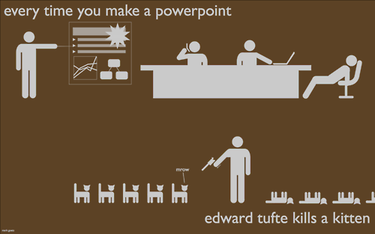
The End

